Slide 1
Robert Reichhard
EDA 530 – Professor Metzger
Exploratory Data Analysis – Final Project

Slide 2
Statistical Question/Hypothesis
Do Arizonans with a master’s degree make more money than those with a bachelor’s degree?

Slide 3
Data
Obtained from the United States Census Bureau
Over 69,000 respondents in 2018
Original dataset had 278 attributes
I chose to keep:
Education level
Earnings
Marital Status
Occupation
Age

Slide 4
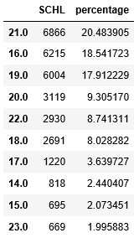
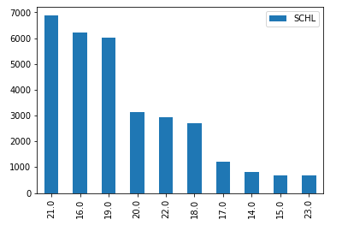
Education Level
Numerical value associated with escalating educational attainment
Starts at 01 (No Schooling completed, not even nursery school or preschool) and ends at 24 (Doctorate degree)
The most frequent education levels were Bachelor’s (21), High School Diploma (16) and 1+ Years of College Credit/No Degree (19)

Slide 5
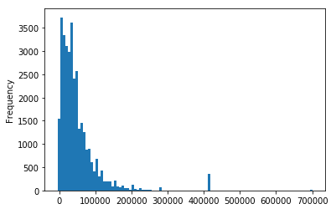
Earnings
Numerical value of respondent’s earnings in United States Dollars
Variable “ADJINC” was multiplied to Earnings to account for inflation
Distribution is skewed right, with outliers above the $400k tic mark
I kept these outliers as at this point in the EDA I do not know their education level and that may influence the outcome
For the adjusted income, the mean is $48178,35. The mode is $30,392.91, and the spread is $3,344,493,984.38

Slide 6
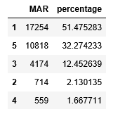
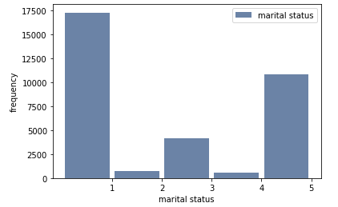
Marital Status
Numerical value of respondent’s martial status at the time of responding
The most frequent marital status was 1, which correlates to married. Next was 5, which correlates to never-married.

Slide 7
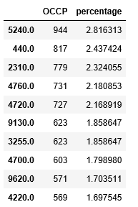
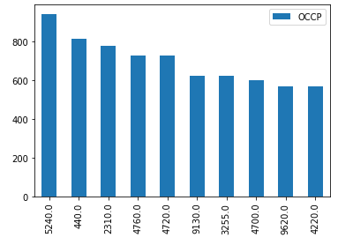
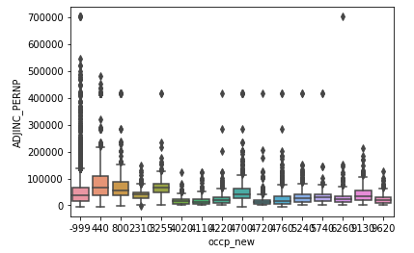
Occupation
Numerical value of respondent’s occupation at the time of responding
The most frequent occupation was Customer Service Representative (5240) followed by Other Manager (440).

Slide 8
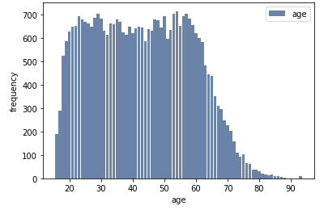
Age
Numerical value of respondent’s years of age at the time of responding
Distribution is close to normal with tails on the left and right, but the peak is very wide
For age, the mean is 42 years of age. The mode is 54 years, and the spread is 237 years.

Slide 9
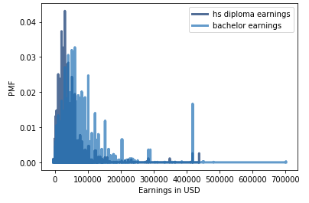
Probability Mass Functions
Looking at the PMF of earnings from respondents with a high school diploma and those with a bachelor’s degree, we still see a majority of the probability mass <$100k
There is a dropoff point <$100k where hs diploma earnings are overshadowed
The outlier group at ~$400k is a majority bachelor earnings

Slide 10
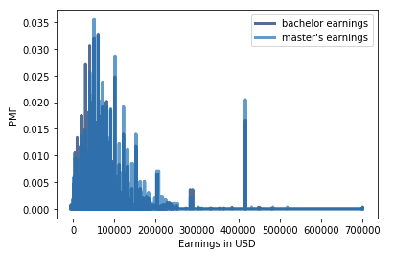
Probability Mass Functions
Looking at bachelor’s respondent earnings and master’s respondent earnings we see much less disparity between the two; the master’s earnings are not towering over the darker blue bachelor earnings
Interestingly we see a group of bachelor’s earnings just under $300k that out-earn master’s respondents

Slide 11
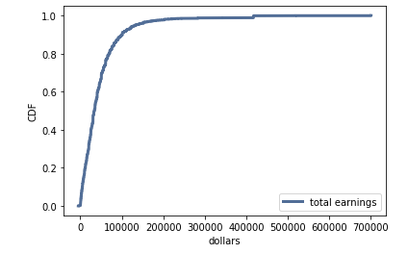
Cumulative Distribution Function
Shown is a CDF of all respondent earnings
The curve is overwhelmingly steep, surpassing 0.8 by 100k
The entire population of respondent earnings is fully accounted for between 400k & 500k
This tells me that a vast majority of respondents earn $100k or less and very few earn more than $200k

Slide 12
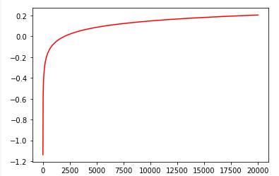
Analytical Distribution
I chose a Pareto Distribution to best represent earnings
Pareto Distributions are primarily used to show inequality of distribution along the “80/20” rule (20% of the population controls 80% of the wealth)

Slide 13
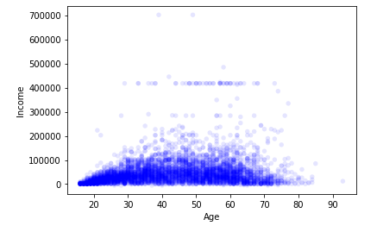
Scatterplots
Comparing respondent age vs earnings
We show a parabolic shape with the earnings of younger respondents starting low and then climbing higher as they age. This may be due to respondents graduating from school, getting promoted or finding new/higher-paying jobs
We also see a dropoff around the mid-60’s. This may be due to older respondents retiring from the workforce

Slide 14
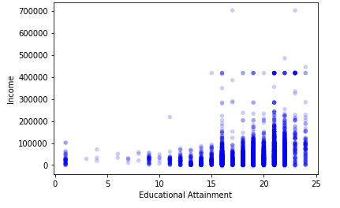
Scatterplots
Comparing respondent educational attainment vs earnings
We see that there is a significant increase in earnings starting at 16 (high school diploma)
The most populous and tallest band appears to be at 21 (bachelor’s degree)

Slide 15
Hypothesis Testing
I chose to use a difference in means calculation for the mean values of bachelor’s degree respondents and master’s degree respondents.
The Pvalue generated showed to be very significant at <0.0
The Bachelor’s earnings mean was $65,584
The Master’s earnings mean was $76,898
This illustrates a significant difference of $11,313 on average between Arizonans with a Bachelor’s education and a Master’s education

Slide 16
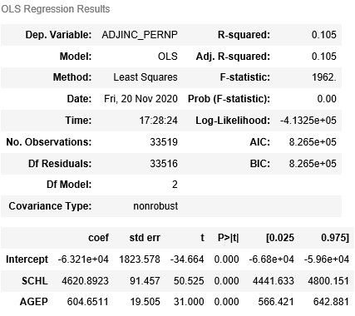
Regression Analysis part 1
I chose to complete a multiple regression analysis. For all of the attempts, I have used adjusted earnings as the dependent variable. The first attempt was using educational attainment and age.
The result was an R-squared value of 0.105 with both age and schooling showing a significant p-value and a positive relationship with earnings

Slide 17
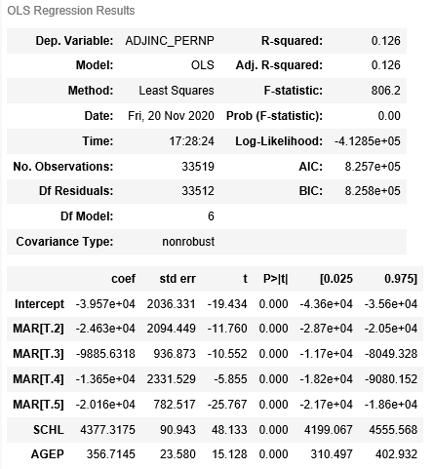
Regression Analysis part 2
The second iteration was using educational attainment, age, and marital status.
The result was an R-squared value of 0.126 (increased from 0.105) with all three independent variables showing a significant p-value.
Schooling and Age still have a positive relationship with earnings
Marital status seems to have a negative relationship. The Marital baseline of 1 is for married respondents. I understand this to mean that as married people no longer remain married through divorce or becoming widowed their earnings decrease

Slide 18
Regression Analysis part 3
The third iteration was using educational attainment, age, marital status, and occupation.
The result was an R-squared value of 0.149 (increased from 0.126) with the three previously used independent variables showing a significant p-value. However a few occupations showed to not have a significant p-value.
These were 3255 (Registered Nurses), 4700 (First Line Supervisors of Retail Workers), and 9130 (Truck Drivers)
Many occupations showed a positive relationship with earnings. The most positive coefficient was 2.797x10^04 for 440 (Other Managers)
Many occupations also showed a negative relationship with earnings. The most negative coefficient was -2.794x10^04 for 2310 (Elementary & Middle School Teachers)

Slide 19
Regression Analysis part 4
The fourth iteration was using educational attainment, age, marital status, occupation, and age-squared. This was done in an attempt to account for the non-linear relationship age has with earnings.
The result was an R-squared value of 0.170 (increased from 0.149) with the new age-squared variable also showing a significant p-value and a negative coefficient of -37.3889
This regression formula including five independent variables has the highest R-squared value showing that these variables account for ~17% of the variability in earnings.

